Slide 1
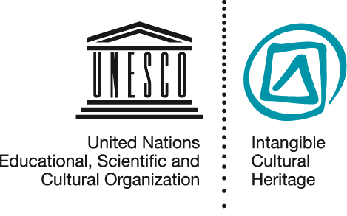
Developing a community participation strategy
NOM PPT 5.12
UNESCO
Intangible Cultural Heritage Section

Slide 2
In this presentation ...
Why community participation
Defining communities, groups, individuals
Roles of stakeholders
Examples
Mechanisms

Slide 3
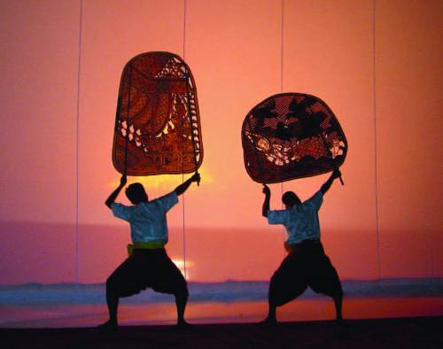
Reasons for community participation
Community members enact ICH, and identify with it;
ICH belongs to their heritage;
Safeguarding means continued practice and transmission by them;
Safeguarding requires their participation and consent
Sbek Thom shadow theatre © National Museum of Cambodia

Slide 4
The nomination file requires proof of:
Community participation in:
- identification of their ICH
- preparation of safeguarding plan
Community consent for submission of nomination
Community commitment to safeguard the element

Slide 5
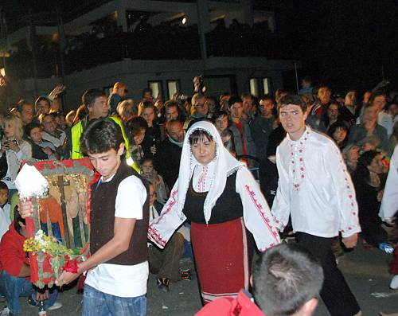
A community participation strategy indicates...
Which community
How their participation is organized and funded
How their consent is given / recorded / withdrawn
How they are involved in nomination preparation
Which other stakeholders are involved
The Panagyr of Saints Constantine and Helena in the village of Bulgari (Bulgaria)
© 2008 by Regional Museum Burgas

Slide 6
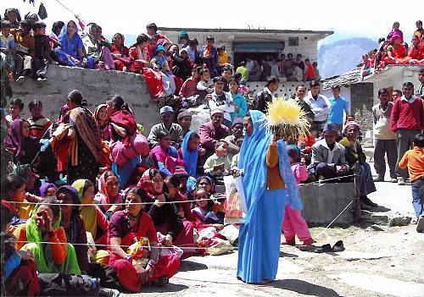
Defining the community concerned
Communities, groups and individuals concerned means those who participate in the practice, development and/or transmission of the ICH element and/or those who consider it to be part of their cultural heritage
Ramman: religious festival and ritual theatre of the Garhwal Himalayas, India © IGNCA, Ministry of Culture

Slide 7
Roles of stakeholders in preparing nomination files
Communities concerned
NGOs etc.
State(s) Party(ies)
Identifying & defining element
Preparing nomination file
Giving free, prior and informed consent
Submitting nomination to UNESCO
Community gives consent
Future safeguarding

Slide 8
Dr Londres Fonseca (IPHAN - Brazil)
“... what is really needed is for the community to participate in the process [of inventorying]... If the inscription takes place without dialogue with the community ... I wonder whether there will actually be any involvement in safeguarding ...”
Notes:
Fonseca interview clip: “In my own opinion, what is really needed is for the community to participate in the process [of inventorying], because otherwise our vision is going to be too remote from what is actually happening and we shall fail to realize that the name and category of the element are not the only thing that matters. What matters above all are its meanings, the values attributed to it and how people practise it, which varies a lot. These are older people, and, of course, an anthropologist’s view helps a lot, but I doubt whether the anthropologist’s view is enough. No doubt an anthropologist is very helpful and knows the methodology, but the problem is not just description, because for us an inventory is the first step towards safeguarding. If the population takes part in the inventory, if the community is involved, it has already become a partner in this process. If the inscription takes place without dialogue with the community, even if there is a formal gesture in this direction, I wonder whether there will actually be any involvement in safeguarding or whether this involvement will have to be built afterwards. This is not impossible, but I think it is better to do it beforehand if possible. However, I realize that scale is something very complicated here, and I think that each country must find its own answers.”

Slide 9
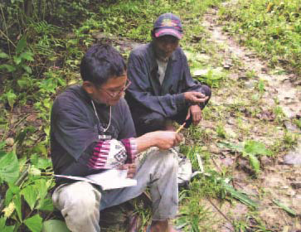
Example: Subanen Community-based documentation
Elders recognized that their knowledge about local plants was not being passed on to younger community members
They asked for help to train young people to document this knowledge within the community
Copyright protection gained
Materials included in the school curriculum
A Subanen member of the
documentation team receiving
information from an older member
of the community.

Slide 10
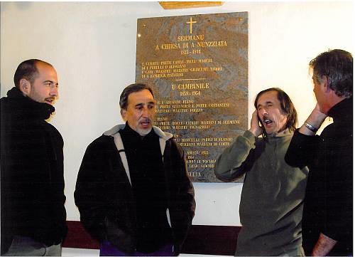
Example: Cantu in Paghjella nomination (Corsica/France)
Polyphonic singing
Expert-practitioner meetings
Formation of a practitioner association
Practitioner involvement in inventorying
Media campaigns
© Michèle Guelfucci-Glinatsis, 2009

Slide 11
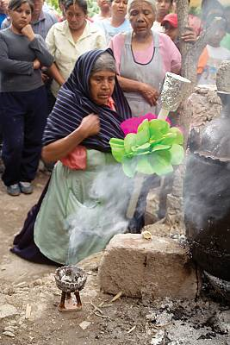
Example: Traditions of the Otomí-Chichimecas (Mexico)
Community consultation meetings and opinion poll
Safeguarding proposals prepared by community
Regional forum and community declaration
Representative management / safeguarding body established
© 2007 Government of the state of Queretaro

Slide 12
Aims of community participation
Inform and consult
Improve communication
Determine consent / not
Determine commitments
Identify ICH value, viability, threats
Prepare and implement nominations and safeguarding plans

